Slide 1
RETAIL STORE SALES FORECASTING Casestudy: BigMart Supermarket (2013 Sales Data)
BY
CHEPKORIR STELLAH ROTICH

Slide 2
Dataset(s)
Dataset used:
BigMart Sales Dataset on Kaggle
https://www.kaggle.com/dataset/BigMartSales

Slide 3
Motivation
Retail industry are collecting huge amounts of dataset and storing it. But much of this data lies somewhere unutilized in making business decisions. Thus there is a need to fill this gap and help retail make decisions and improve sales and operations based on data .

Slide 4
Research Questions
The stores which are high in size make more sales that those which are small in size because of products capacity
The products that are healthy for consumption have higher sales as they are used regularly as more people are becoming conscious of their health
Stores located that were established several years ago make more sales

Slide 5
Methodology
Data Cleaning
Feature Engineering
Data Analysis
Modeling(Linear Regression, Random Forest, Decision Tree)
Prediction of sales

Slide 6
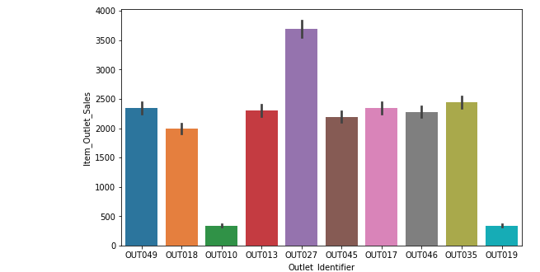
Findings

Slide 7
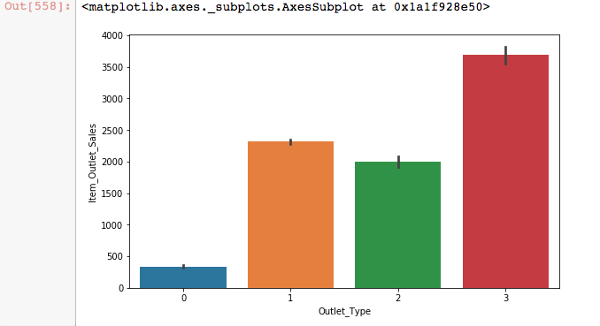
Sales Vs Outlet Type

Slide 8
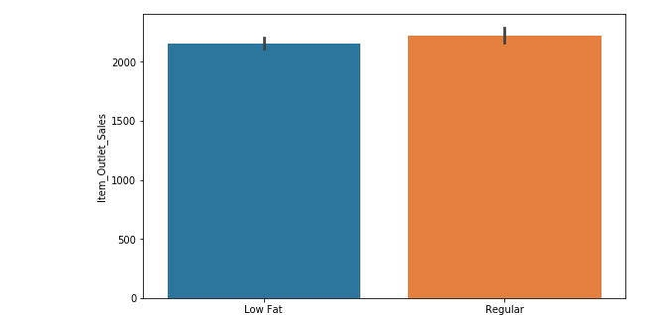
SALES vs Fat_Content in Items

Slide 9
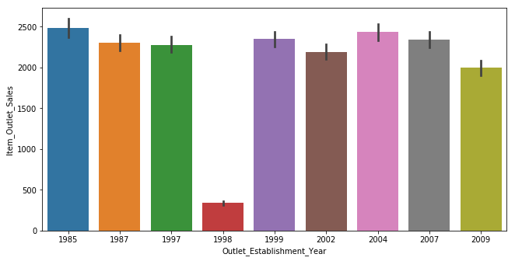
Outlet_Year_of_Establishment vs Sales

Slide 10
Acknowledgements
Analythics Vidhya Team - Machine Learning Blog
Kaggle - Discussion Forum

Slide 11
References
https://mef-bda503.github.io/gpj-datamunglers-2/files/LastVersion/20180105_BigMart.pdf

